Slide 1
Heat Transfer
PRINCIPLE OF CONVECTION AND BOUNDARY LAYER

Slide 2
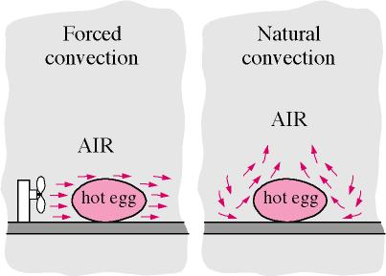
In convection heat transfer
There is a flow of fluid associated with heat transfer and the energy transfer mainly due to bulk motion of the fluid.
When the flow of fluid is caused by an external agency such as a fan or pump, the resulting heat transfer is known as 'Forced convection heat transfer;
When the flow of fluid is due to density differences caused by temperature differences, the heat transfer is said to be by 'Natural (or free) convection'

Slide 3
Newton's Law of Cooling and Heat Transfer Coefficient
$$q_{conv}=h.\left(T_{s}−T_{a}\right)$$
heat transfer coefficient, h, depend on several factors such as:
the fluid properties like density, viscosity, thermal conductivity and specific heat,
type of flow (laminar or turbulent) i.e. (velocity of the flow, shape of fluid passage (circular, rectangle or a flat surface)
nature of the surface (rough/smooth) and
orientation of the surface
Nusselt Number
Since we know that adjacent to the solid surface the fluid layer is stationary and the heat transfer in this fluid layer is by conduction
$$q_{cond}=−k_{f}({dT}/{dy)}$$
and the heat transferred by convection subsequently must be equal to this fluid layer, we can equate Eqs. a and b:
$$h.\left(T_{s}−T_{a}\right)=−k_{f}({dT}/{dy)}$$
$$h={(−k_{f}({dT}/{dy)})}/{\left(T_{s}−T_{a}\right)}$$

Slide 4
$$\frac{q_{conv}}{q_{cond}}=\frac{h . ∆T}{k_{f} . \frac{∆T}{δ}}=\frac{h.δ}{k_{f}}=Nu$$
It is also common practice to non-dimensionalise the heat transfer coefficient with 'Nusselt number.
In other words, Nusselt number tells us how much the heat transfer is enhanced due to convection as compared to only conduction.
higher the Nusselt number, larger the heat transfer by convection.

Slide 5
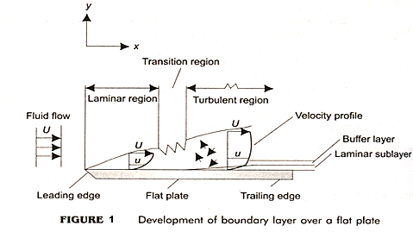
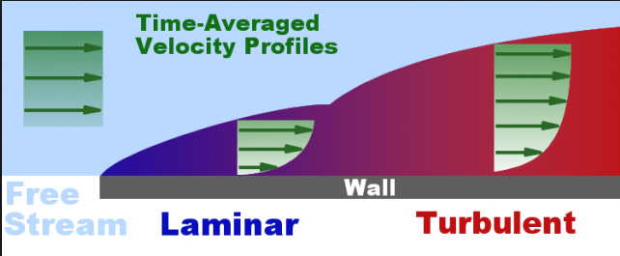
Velocity boundary layer
Let a fluid approach the flat plate at a free stream velocity of U.
The fluid layer immediately in contact with the plate surface adheres to the surface and remains stationary.
Then, the fluid layer next to this stationary layer has its velocity retarded because of the viscosity effects.
This effect continues with subsequent layers up to some distance in the y-direction till the velocity equals the free stream velocity U.
This region of fluid layer in which the viscosity effects are predominant is known as the 'velocity (or hydrodynamic) boundary layer', or simply the 'boundary layer'.

Slide 6
The boundary layer divides the flow field into two regions: one, 'the boundary layer region' where the viscosity effects are predominant and the velocity gradients are very steep, and, second, inviscid region'
Since the fluid layers in the boundary layer travel at different velocities, the faster layer exerts a drag force ( or frictional force) on the slower layer below it; the drag force per unit area is known as shear stress ($τ$)'.
$$τ_{s}=μ.{\left(\frac{dU}{dy}\right)}_{y=0} N/{m^{2}}$$
Use of the above Eq. to determine the surface shear stress is not very convenient, since it requires a mathematical expression for the velocity profile; so, in practice, the following relation:
$$τ_{s}=C_{f}\frac{{ρU}^{2}}{2} N/{m^{2}}$$
where $C_{f}$ is a 'friction coefficient' or 'drag coefficient'. $C_{f}$ is determined experimentally in most cases. Drag coefficient varies along the length of the flat plate. Average value of drag coefficient $(C_{fa})$ then the drag force over the entire plate surface is determined from:
$$F_{D}=C_{fa}.A.\frac{{ρU}^{2}}{2} N$$
where A = surface area, m².

Slide 7
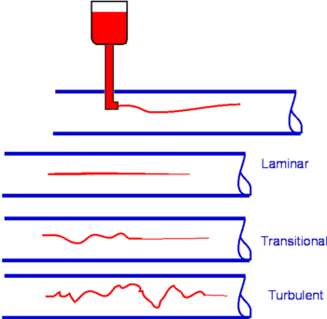
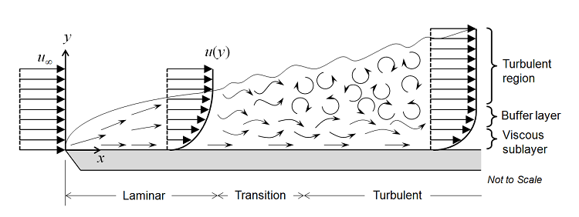
Starting from the leading edge of the plate, for some distance along the length of the plate, the flow in the boundary layer is 'laminar' i.e. the layers of fluid are parallel to each other and the flow proceeds in a systematic, orderly manner.
after some distance, disturbances appear in the flow and beyond this 'transition region',
flow becomes completely chaotic and there is complete mixing of 'chunks' of fluid moving in a random manner i.e. the flow becomes 'turbulent'.
Transition from laminar to turbulent flow depends primarily on the free stream velocity, fluid properties, surface temperature and surface roughness, and is characterized by 'Reynolds number'. Reynolds number is a dimensionless number, defined as:
Re = (Inertia forces/Viscous forces). Or,
$$Re=\frac{U.x}{v}$$

Slide 8
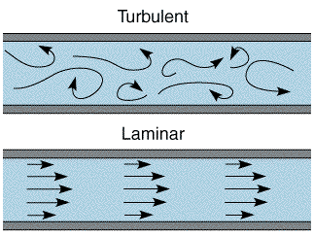
special efforts are made in the design of heat exchangers to increase turbulence.
Turbulent boundary layer itself is made of three layers: a very thin layer called laminar sub-layer', then, a "buffer layer' and, finally, the 'turbulent layer',
Thickness of the boundary layer, $δ$, increases along the flow direction; $δ$ is related to the Reynolds number as follows: in the laminar flow region:
$$δ_{lam}=\frac{5.x}{{({Re}_{x})}^{0.5}}$$
and for turbulent flow region:
$$δ_{turb}=\frac{0.376.x}{{({Re}_{x})}^{0.2}}$$
where ${Re}_{x}$ is the Reynolds number at position x from the leading edge.

